Slide 1
PROCUREMENT GATEPASS AND VENDOR DUE EMAIL

Slide 2

Team
Gurucharan Talupuri- 280384
Tauheer Ahamed Shaik -280420
Mhetre Vaishnavi -280405

Slide 3
Table Of Contents
Material Table | Z007_TAB1
Vendor Table | Z007_TAB2
Purchase Order Table | Z007_TAB3
Alv Report | Z007_ALV_OOPS_PROG
Cds View | Z007_ADOBEFORM_PROG
Adobe Form | Z007_CDS_DRIVER_PROGRAM

Slide 4
INTRODUCTION
Generating AlV Report by passing selection screen input of vendor details and purchase details.
ALV Report contains items which are due or undelivered.
CDS View has the fields selected for input.
Report output to have print option for printing “Gatepass” which contains vendor details and items which are due or undelivered.
Email is used for sending mail to vendor regarding list of due products and to get them delivered.

Slide 5
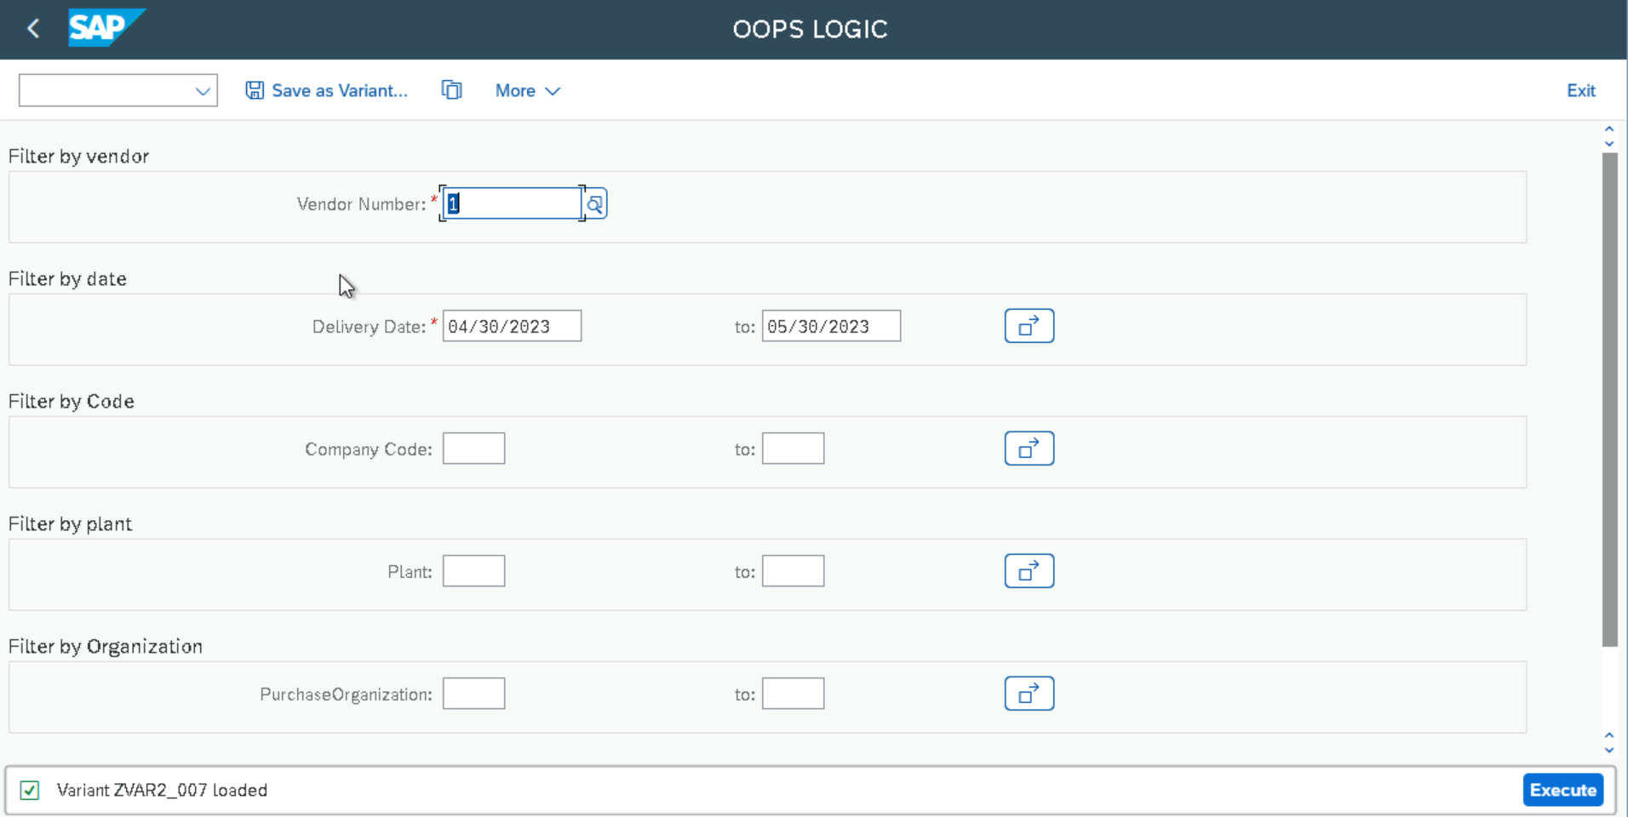
Selection Screen

Slide 6
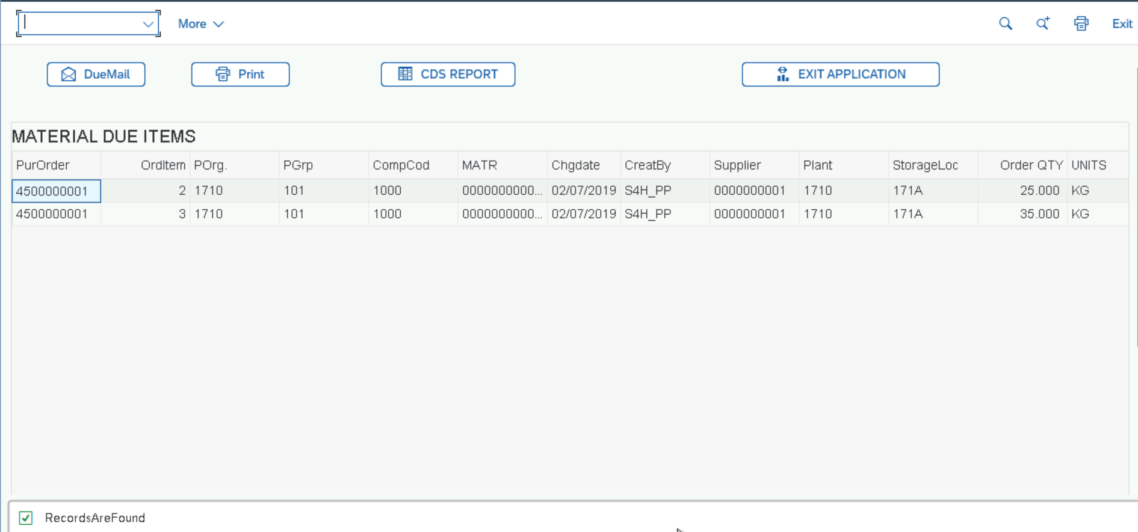
ALV Report

Slide 7
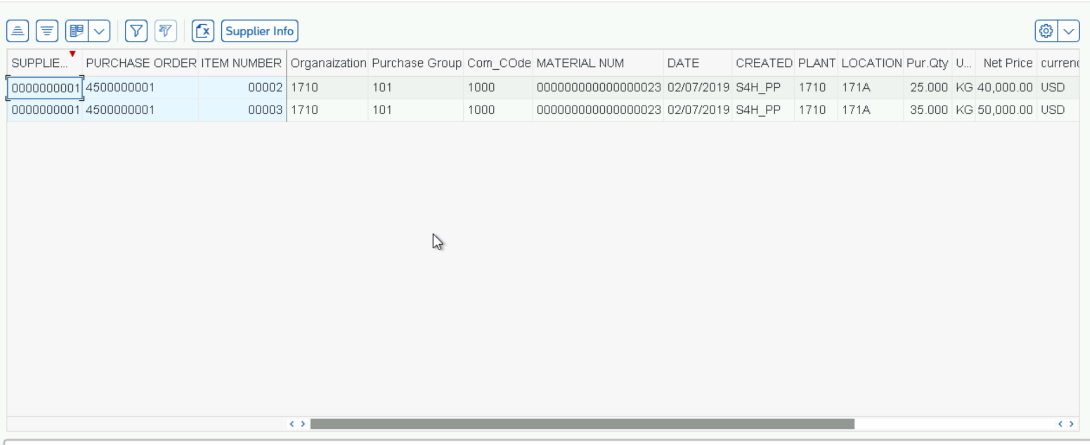
CDS View

Slide 8
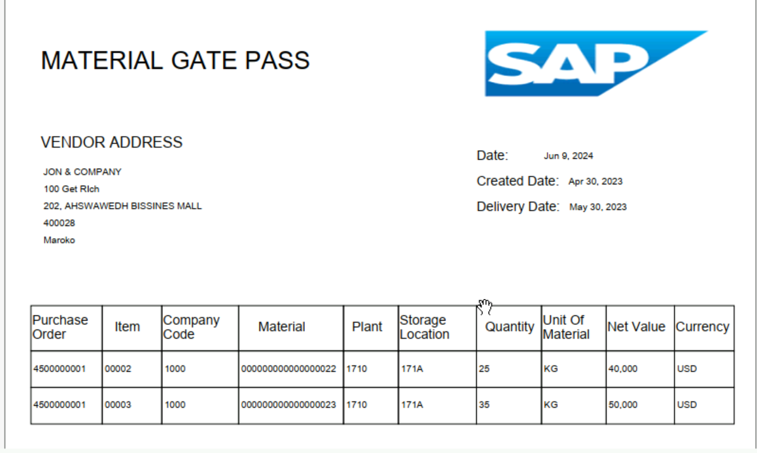
Adobe Form

Slide 9
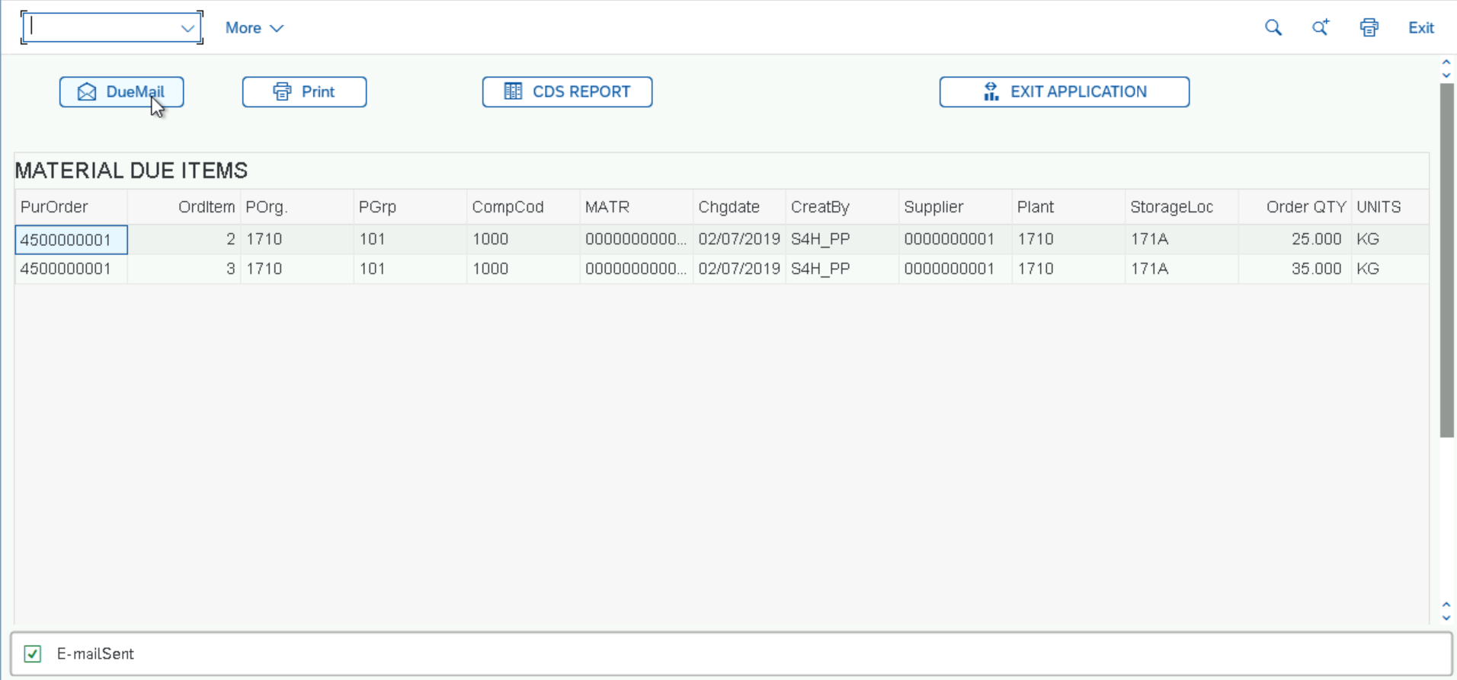
Email Output

